Slide 1
Keshav Kumar
TGA March 2023

Slide 2
Goldman Sachs - IMD onboarding Tech Stack
Java 8
Spring Boot
Kafka
Kubernetes
Gitlab
Mongo DB
MySQL
Redis
Prometheus
Angular
Apache Geode
Sonar
Cucumber
AWS

Slide 3
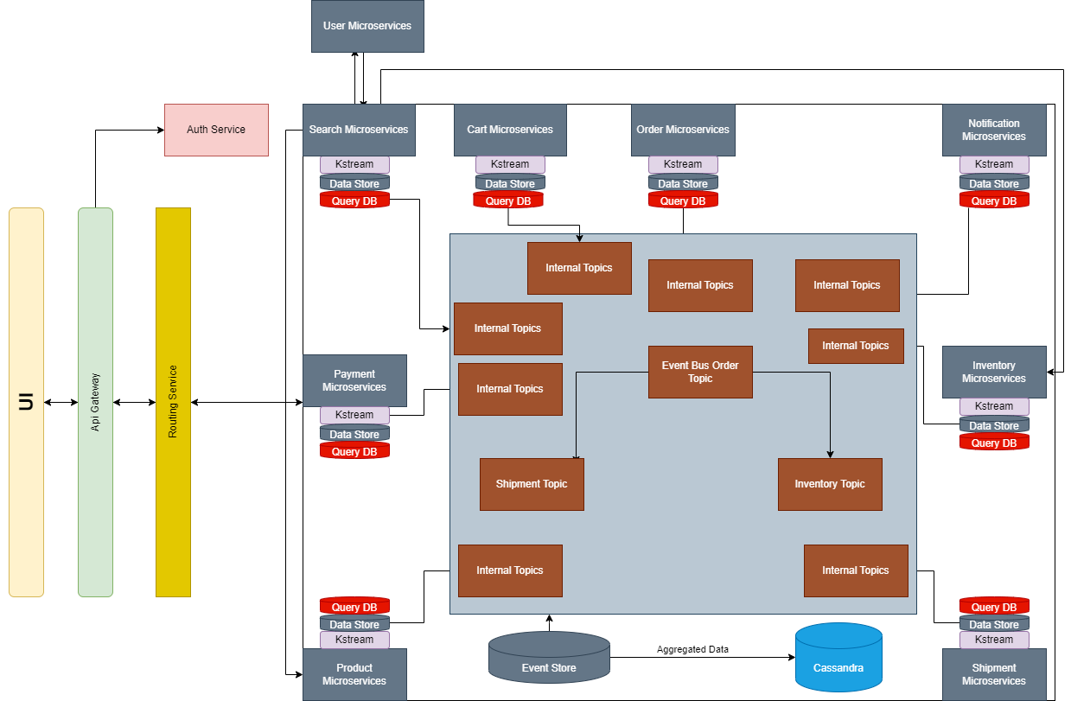
Architecture Diagram

Slide 4
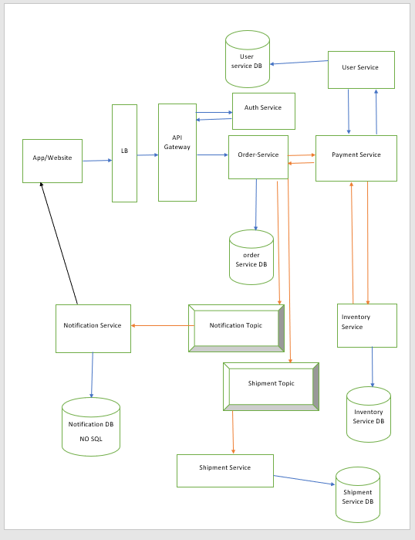
Flow for booking an order

Slide 5
Artifacts
Working Codebase
Kafka implementation
RDBMS implementation (MySQL DB)
NoSQL(Mongo DB)
Cloud setup in local (Docker, Kubernetes Minikube,Helms)
Code Quality and Testing Framework (Unit Testing, Integration Test, BDD Cucumber)
Swagger Open API Specification

Slide 6
Non Functional Requirement
Scalability (Horizontal scaling, load balancing, auto-scaling, stateless services, asynchronous communication, caching) – Using Redis cache, Kafka event sourcing, Multiple instances of a service, Load Balancer
1
Availability (Fault tolerance, redundancy, monitoring, and alerting)- Multiple replicas of services and database, Prometheus and grafana, Circuit breaker
2
Reliability (Key factors: Testing, quality assurance, error handling, logging, tracing, and rollback strategies) – distributed log tracing using zipkins, versioning of services for rollback
3
Performance (Key factors: Optimization, caching, data compression, load balancing, and efficient resource utilization) – Redis, load balancer
4
Security (Authentication, authorization, encryption, network security, and compliance with security standards and regulations.) – Token based access , Role based access
5
Maintainability(Modularity, loose coupling, versioning, documentation, and continuous integration and deployment) – CICD using pipelines, Event based communication and rest api calls , versioning of API, Swagger , Confluence
6

Slide 7
URL :
https://tools.publicis.sapient.com/bitbucket/projects/TGAB/repos/keshav-kumar/browse
https://tools.publicis.sapient.com/confluence/display/TGAB/POS+Architecture

